Slide 1

E-Commerce
Suyesh Pandit

Slide 2
Agenda
Problem Statement
Key Metrics
Total Sales by Product Category
Unique Customers by Year
Total Sales by Product
Average of Wait times by Delivery Type
Revenue Distribution
Monthly Sales: Current Year vs Previous Year
Reports

Slide 3
Problem Statement
You are working as a business analyst at Amazon, a company currently performing well. The stakeholders wish to maintain this level of performance and seek improvement. For this purpose, they want to devise new strategies.
You are part of a team exploring new ways to benefit customers, such as offering more discounts and Prime membership perks. Could you suggest additional methods to identify and reward customers and enhance their shopping experience?

Slide 4
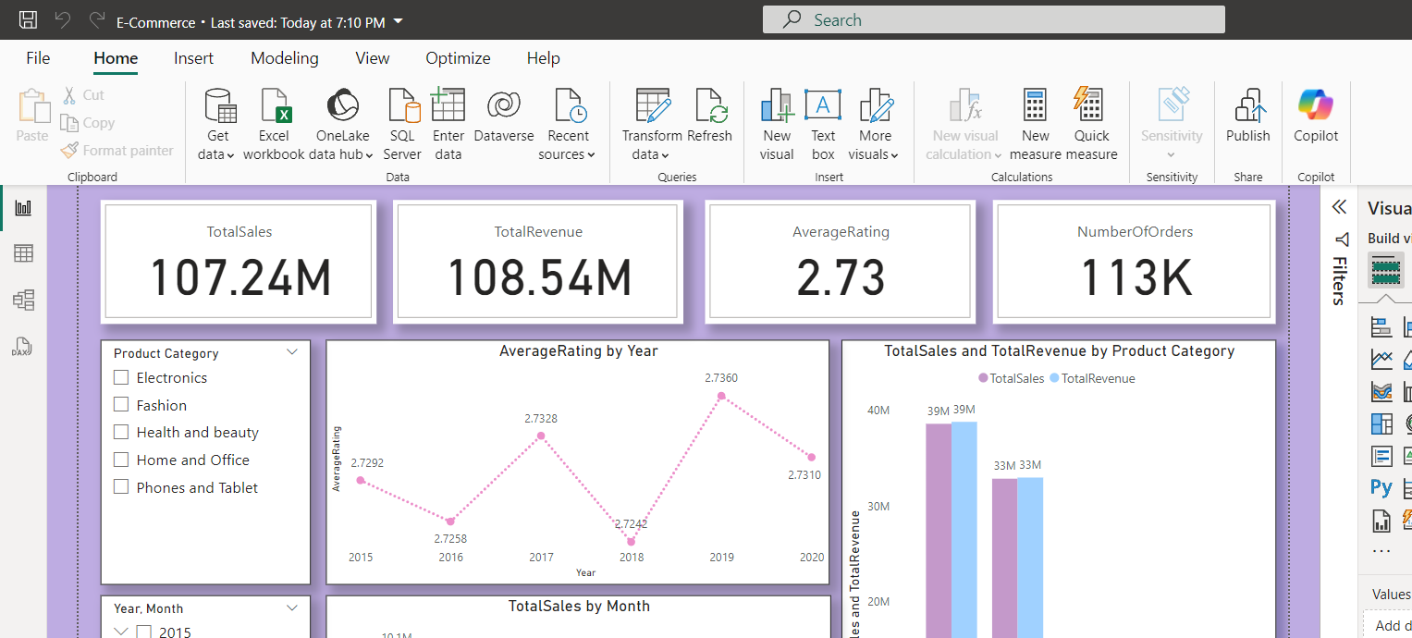
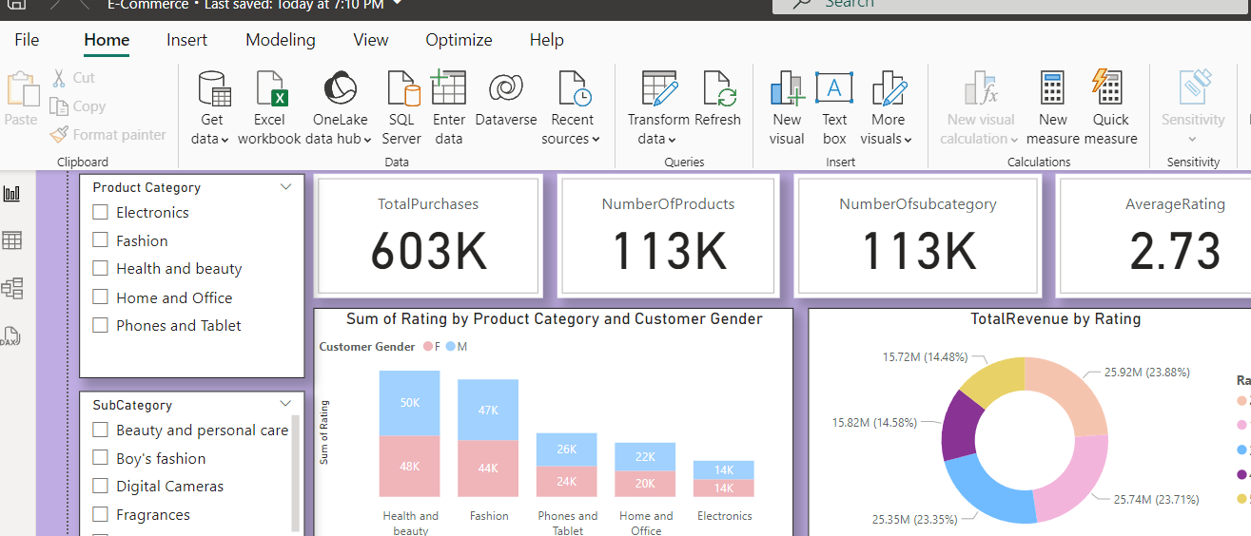
Key Metrics

Slide 5
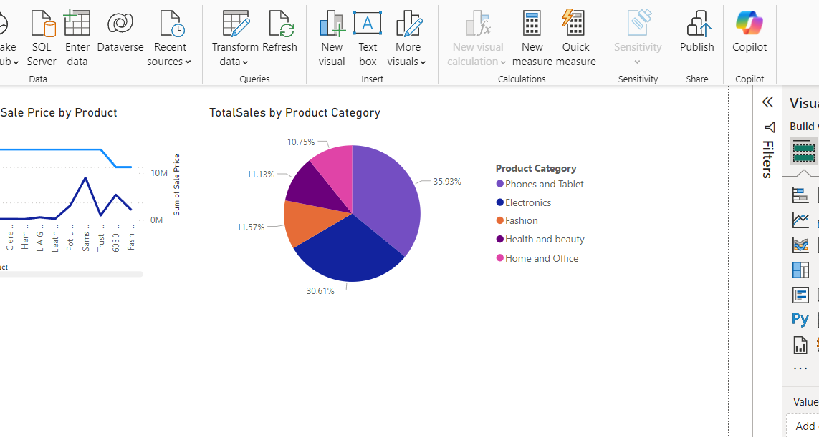
Total Sales by Product Category
The top-selling product categories are Phones and Tablets (36%) and Electronics (30.6%), suggesting that focusing marketing campaigns on these areas could boost sales further.
Fashion (11.57%) and Health and Beauty (11.13%) show moderate sales figures, indicating room for growth through expanding product offerings or targeted marketing efforts.
Home and Office products represent 10.75%, the smallest share among the categories, yet still account for a notable portion of the market.

Slide 6
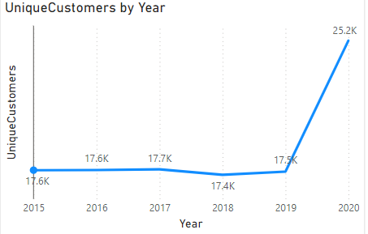
Unique Customers by Year
From 2015 to 2019, the number of unique customers stayed relatively constant, ranging from 17,400 to 17,700. This indicates that the customer base remained steady over these years.
However, in 2020, there was a significant rise to 25,200 unique customers, signaling a substantial increase in customer acquisition.

Slide 7
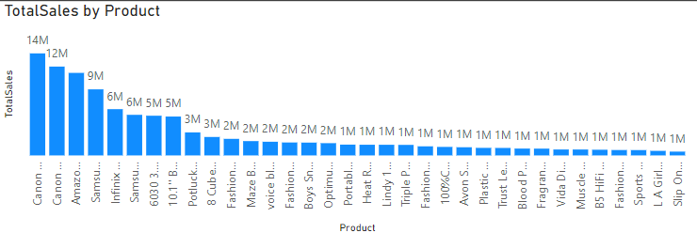
Total Sales by Product
The Canon EOS 600D and Canon EOS 60D DSLR cameras are the best-sellers, indicating a high demand for premium photography equipment.
The Amazon Fire HD 8 Kids Tablet and Samsung Galaxy A02 smartphone also demonstrate strong sales, reflecting a growing interest in affordable and family-oriented devices.
Products with sales in the range of 1M to 2M, though more specialized, still offer growth opportunities. By adjusting marketing approaches or expanding product offerings, these products can increase visibility and drive further sales.

Slide 8
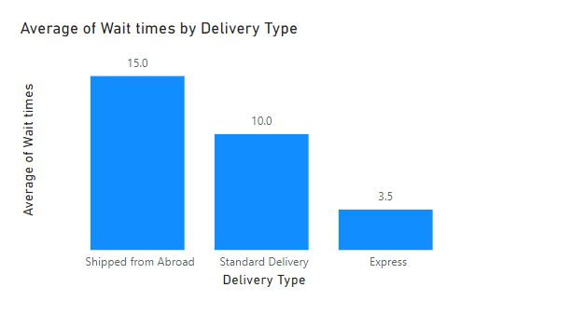
Average of Wait times by Delivery Type
There is a clear correlation between average wait times and delivery method when it comes to ordering and receiving a product.
The data shows notable variations in wait times across different delivery options: "Shipped from Abroad" (15.0 days) has the longest delivery times, while "Express Delivery" (3.5 days) provides the quickest service.

Slide 9
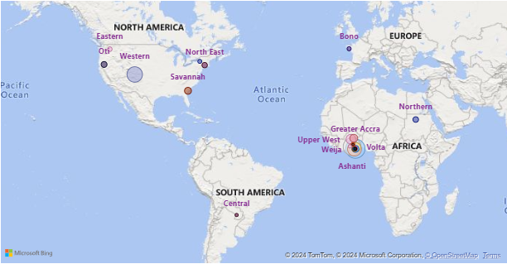
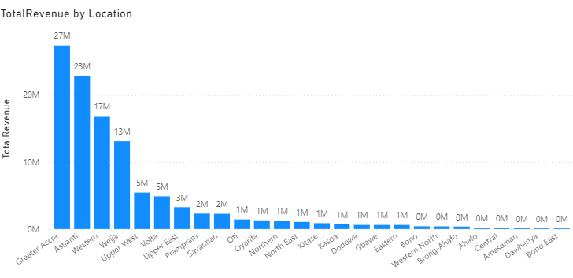
Revenue Distribution
The Greater Accra, Ashanti, and Western regions show high demand for products, presenting key opportunities for marketing and business expansion.
Regions such as Prampram, Savannah, and North East offer potential for increasing market share by customizing strategies to meet local demands and promoting products more effectively.
On the other hand, Amasaman, Bono East, and Dawhenya regions show lower sales, possibly due to smaller populations or less commercial development compared to the higher-performing regions.

Slide 10
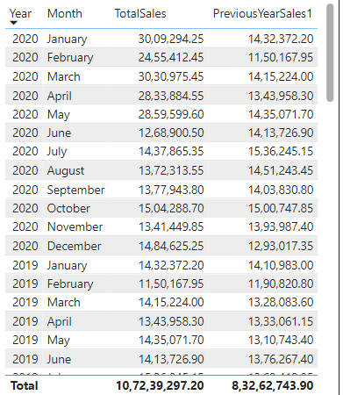
Monthly Sales: Current Year vs Previous Year
The early months of 2020 saw strong sales growth, likely driven by factors such as seasonal trends and new product launches that increased demand for certain items.
February experienced lower sales, suggesting that targeted promotions could help boost performance during this period.
Months like May and October showed strong sales, indicating potential peak demand periods.
Higher sales in July and March could be attributed to focused promotional efforts, which may provide valuable insights for adjusting marketing strategies to counter any future declines.

Slide 11
Recommendations
Market Segmentation Analysis: Leverage customer demographic data such as age, gender, and location to conduct a market segmentation analysis. This approach will help create targeted marketing strategies tailored to specific customer segments and geographic regions.
Reduce Waiting Times: Enhance customer satisfaction by focusing on reducing waiting times, particularly for products shipped from abroad, ensuring faster delivery and a better overall experience.
Regular Performance Evaluation: Perform periodic assessments of delivery performance metrics, including delivery times, accuracy, and customer feedback, to pinpoint areas that require improvement and optimize processes.
Customer Loyalty Program Design: Develop and implement a customer loyalty program based on purchasing behavior, frequency, and spending patterns. Offer personalized incentives, rewards, and exclusive benefits to foster customer retention and loyalty.
Promotional Strategy Optimization: Analyze sales data to uncover seasonal trends, peak demand periods, underperforming months, and successful marketing campaigns. Use this information to optimize promotional strategies and boost sales during key timeframes.

Slide 12
Reports

Slide 13
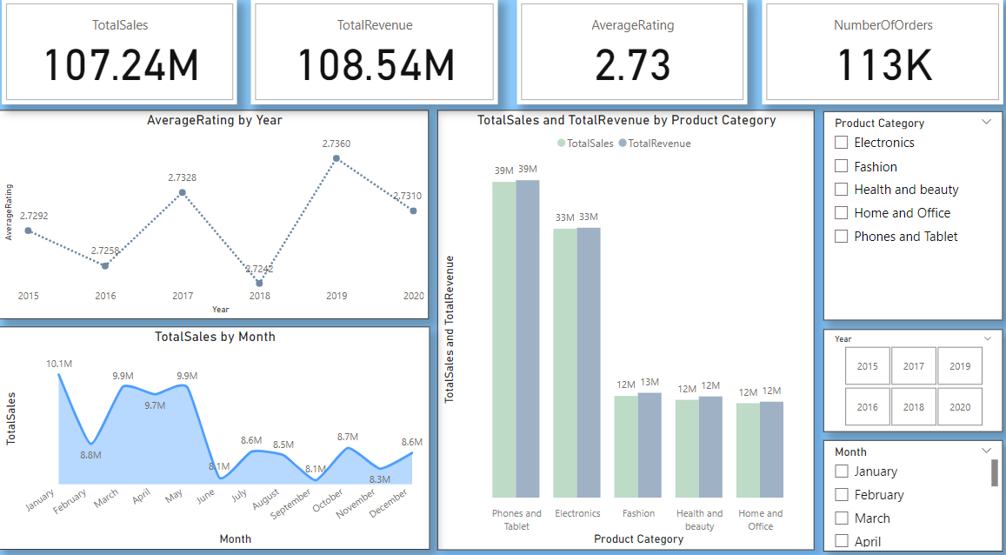
Amazon Sales Analysis

Slide 14
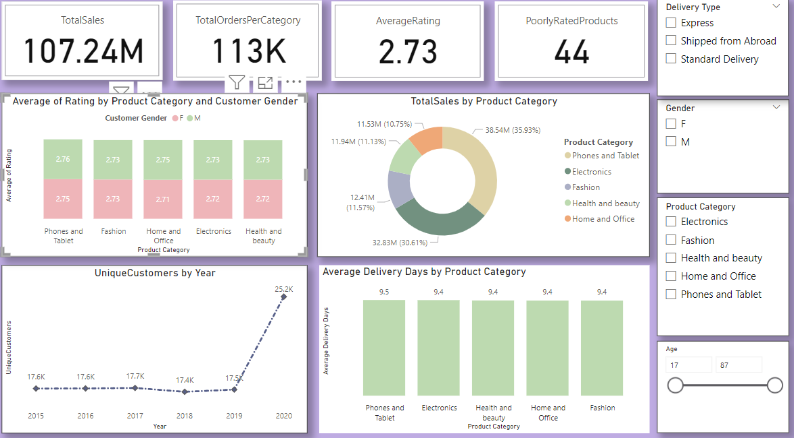
Product Category Analysis

Slide 15
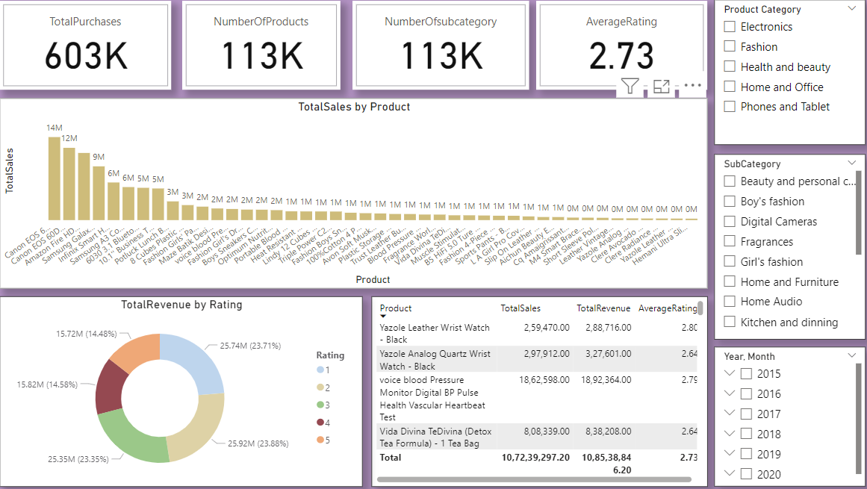
Individual Product Analysis

Slide 16

Thank You

